Slide 1
Waste Management and Disposal
CGPRT(W) : Ensuring Clean Seas and Coasts in Western Region ……

Slide 2
Objectives
To understand the importance of waste management during an oil spill response;
To identify best practices in order to minimize the amount of waste generated during an oil spill.
CGPRT(W) : Ensuring Clean Seas and Coasts in Western Region ……

Slide 3
Issues
Planning
Types of waste
Temporary/intermediate storage
Transportation
Final disposal
CGPRT(W) : Ensuring Clean Seas and Coasts in Western Region ……

Slide 4
Worse Case Scenario: How Much Waste?
For 1,000 m³
25% Evaporated
750 m³
Emulsified (80% water)
3,750 m³
20% Recovered at Sea
3,000 m³
750 m³ liquid waste for disposal
Impact the shoreline (mixed with 10x its volume of debris)
30,000 m³ solid waste for disposal
CGPRT(W) : Ensuring Clean Seas and Coasts in Western Region ……

Slide 5
Waste management challenges can seriously affect the response efficiency
CGPRT(W) : Ensuring Clean Seas and Coasts in Western Region ……

Slide 6
Waste Hierarchy
Response priority should be to minimize waste production as much as possible!
Reduce
Re-use
Recycle
Recover
Dispose
CGPRT(W) : Ensuring Clean Seas and Coasts in Western Region ……

Slide 7
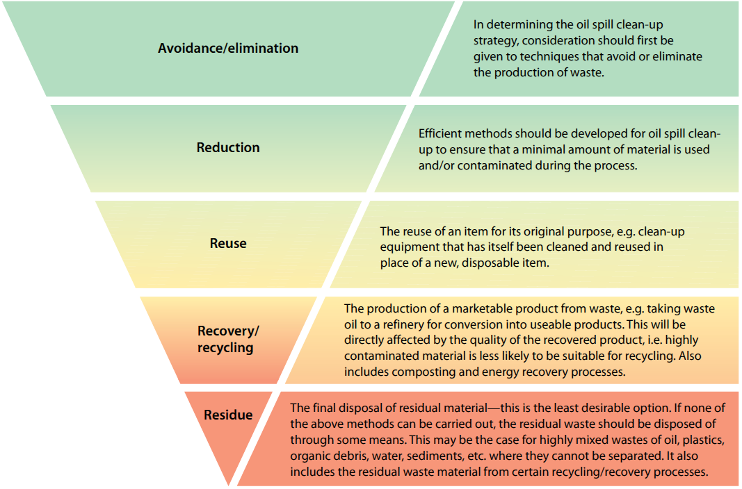
Waste Hierarchy
CGPRT(W) : Ensuring Clean Seas and Coasts in Western Region ……
Source: IPIECA

Slide 8
Waste Management Planning
Should be carried out pre-spill and integrated into the contingency plan
Clean-up choices affect available disposal options
Minimize and segregate waste
Regulations, permits, approvals
Must comply with local regulations
CGPRT(W) : Ensuring Clean Seas and Coasts in Western Region ……

Slide 9
Waste Management Planning
Estimate volumes
Calculate resources required/available
Determine temporary storage sites and transportation methods
Minimize contamination of new sites
Determine final disposal sites
Cost-effective solutions
CGPRT(W) : Ensuring Clean Seas and Coasts in Western Region ……

Slide 10
Types of Waste
Solid:
Oiled sediment
Oiled driftwood/seaweed
Oiled debris
Cleaning materials
Sorbent materials
PPE
Liquid:
Oil
Oil/water mixture
Emulsion
CGPRT(W) : Ensuring Clean Seas and Coasts in Western Region ……

Slide 11
Temporary and Intermediate Storage
Significant quantities of waste are generated during clean-up operations
Mainly by recovery at sea and shoreline clean-up
Significantly less waste generated by using dispersants and in situ burning
If no storage is available, recovery operations will have to stop!
Important to think about the waste stream before beginning oil recovery operations
CGPRT(W) : Ensuring Clean Seas and Coasts in Western Region ……

Slide 12
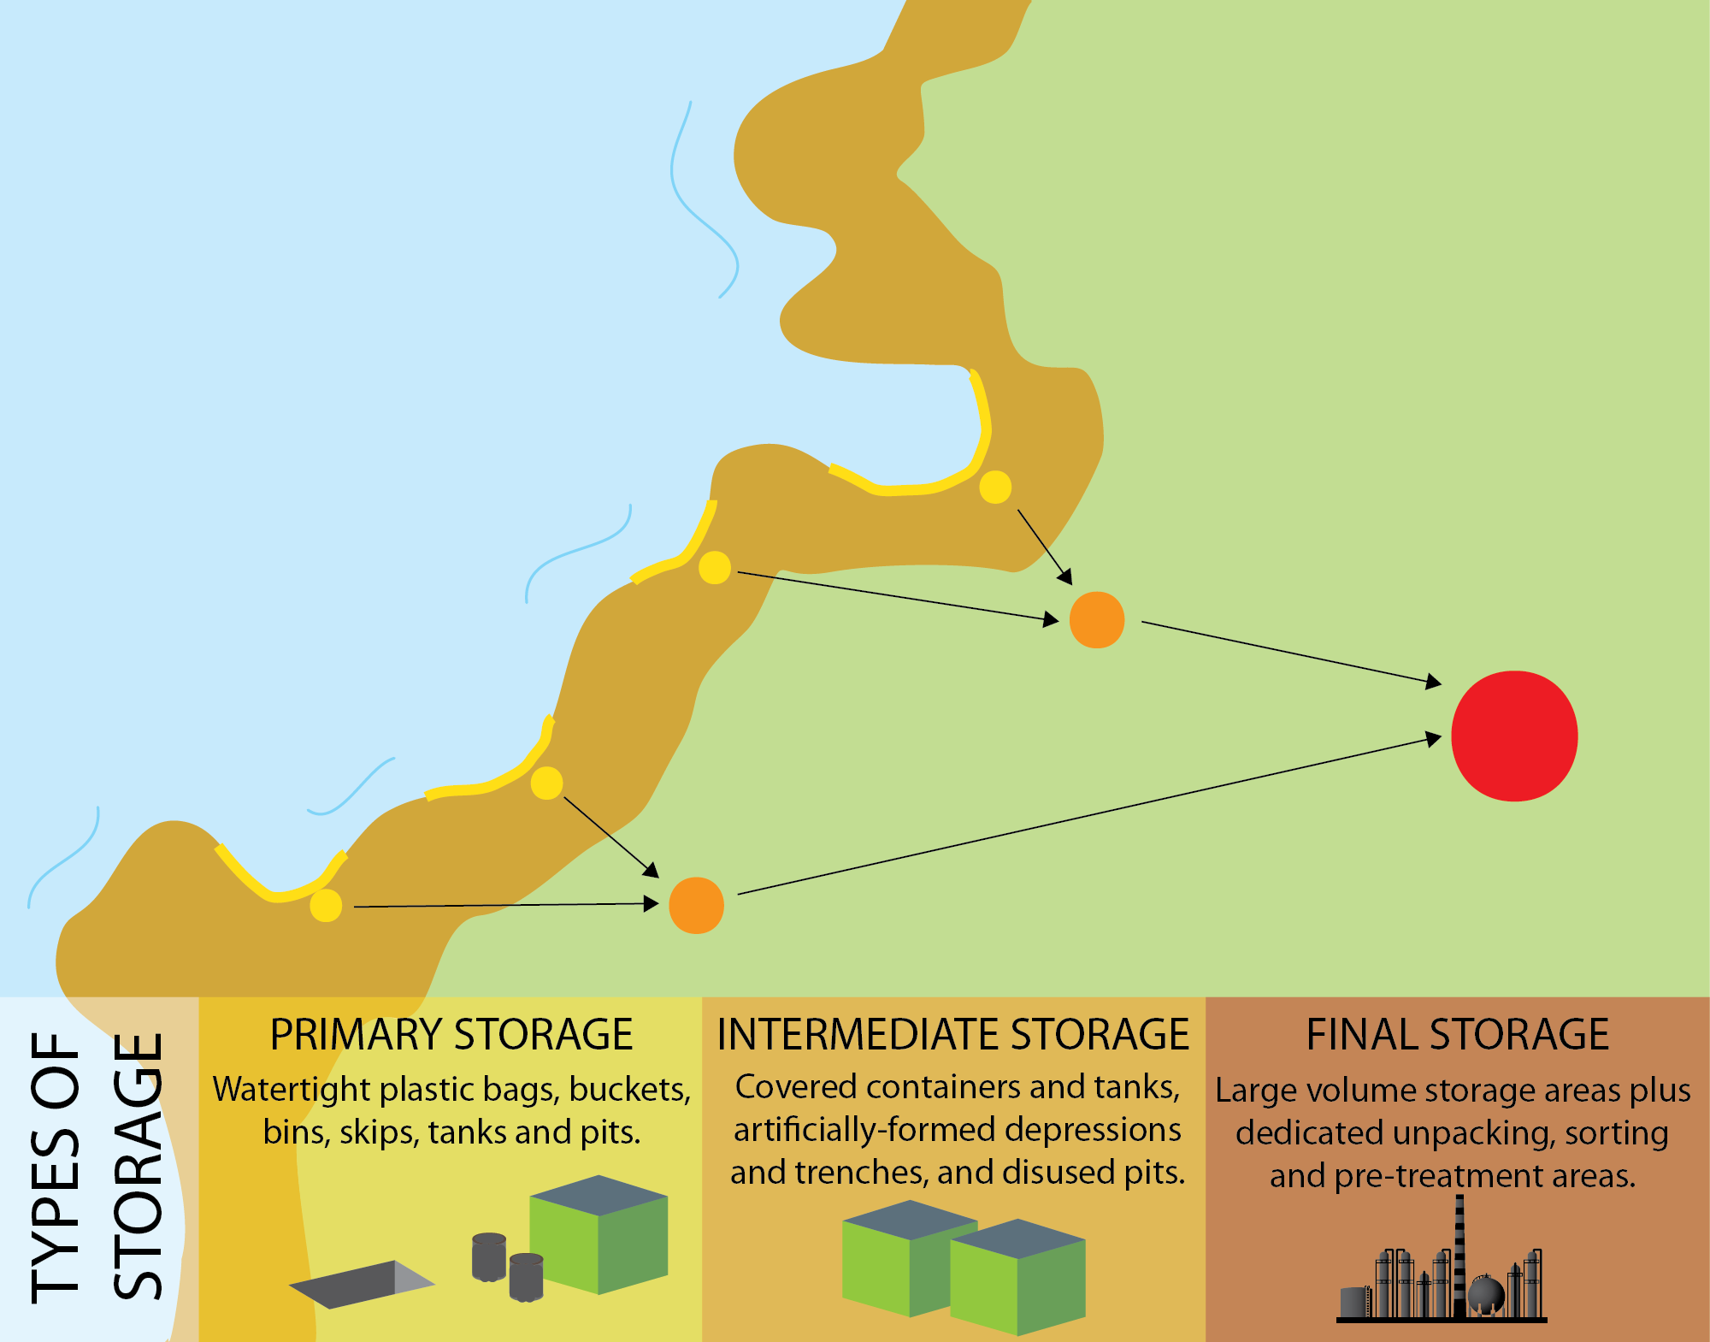
Waste Stream
Source: OSRL
CGPRT(W) : Ensuring Clean Seas and Coasts in Western Region ……

Slide 13
Temporary Storage
At sea:
Barges
Vessel tanks
Floating tanks
Onshore:
Skips
Portable tanks
Drums
Lined excavated (temporary) pits
Plastic bags
CGPRT(W) : Ensuring Clean Seas and Coasts in Western Region ……

Slide 14
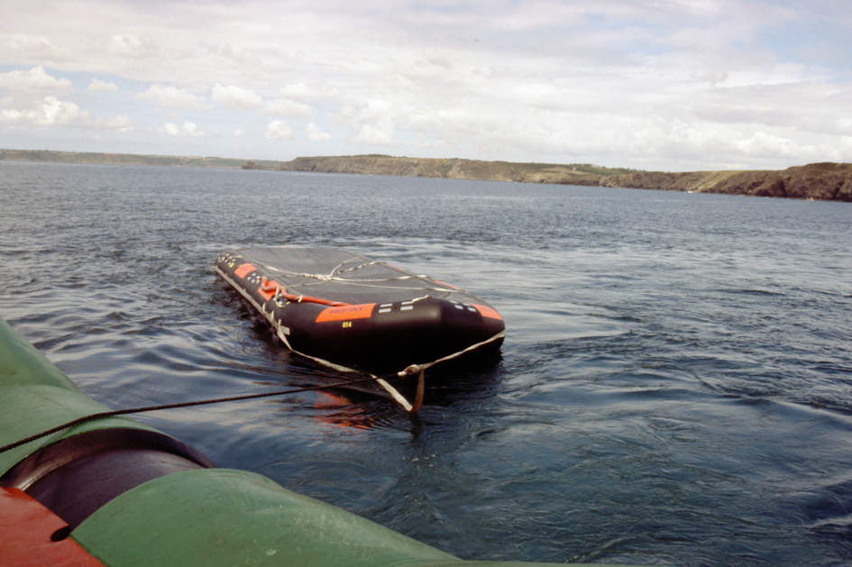
At-sea Storage
CGPRT(W) : Ensuring Clean Seas and Coasts in Western Region ……

Slide 15
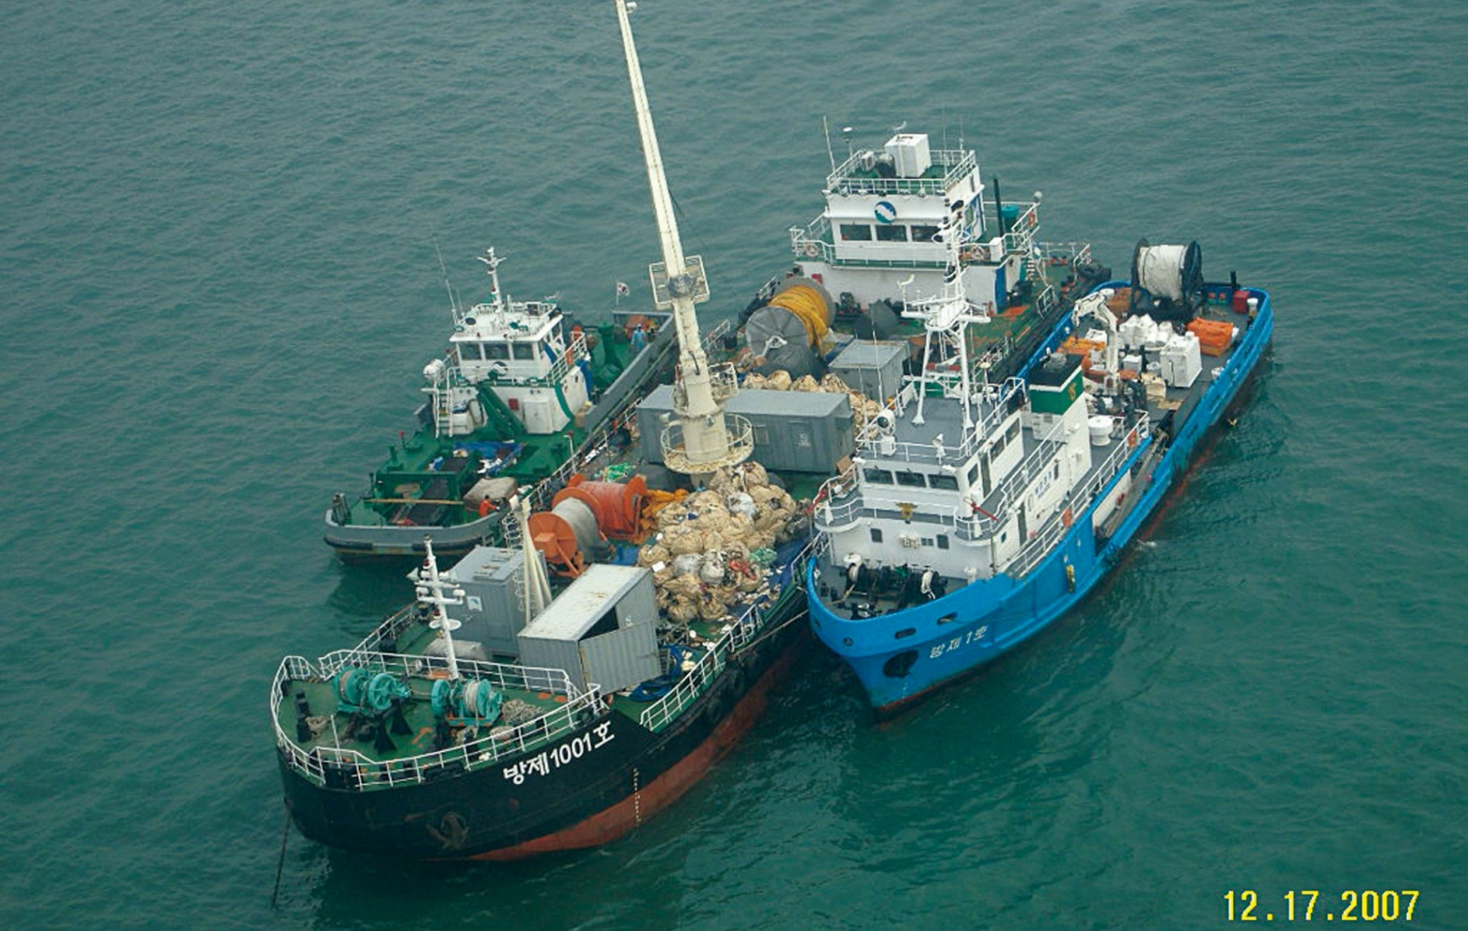
At-sea Storage
CGPRT(W) : Ensuring Clean Seas and Coasts in Western Region ……

Slide 16
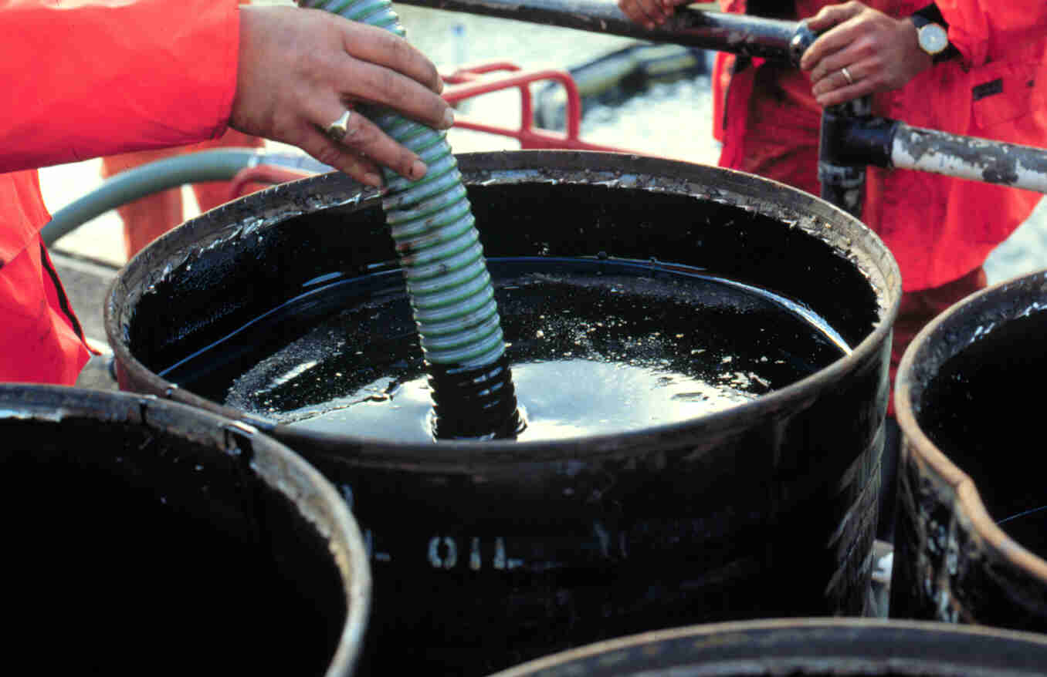
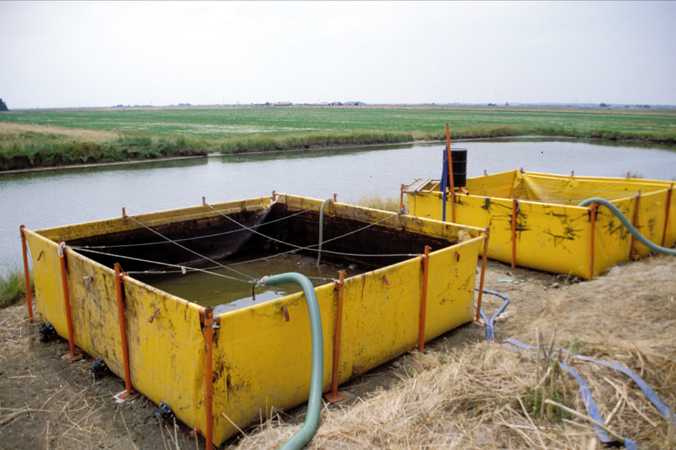
Onshore Storage
Source: OSRL
Source: CEDRE
CGPRT(W) : Ensuring Clean Seas and Coasts in Western Region ……

Slide 17
Temporary Storage
Prevent secondary contamination
Ensure storage is water/oil proof to avoid leakage
Ensure site is suitable for temporary containers
Flat with stable ground
Easy access for heavy equipment
Close to recovery sites
Install liner under temporary containers
Keep absorbent nearby in case of a small spill
Ensure all vehicles used for waste transportation are decontaminated before leaving response sites
CGPRT(W) : Ensuring Clean Seas and Coasts in Western Region ……

Slide 18
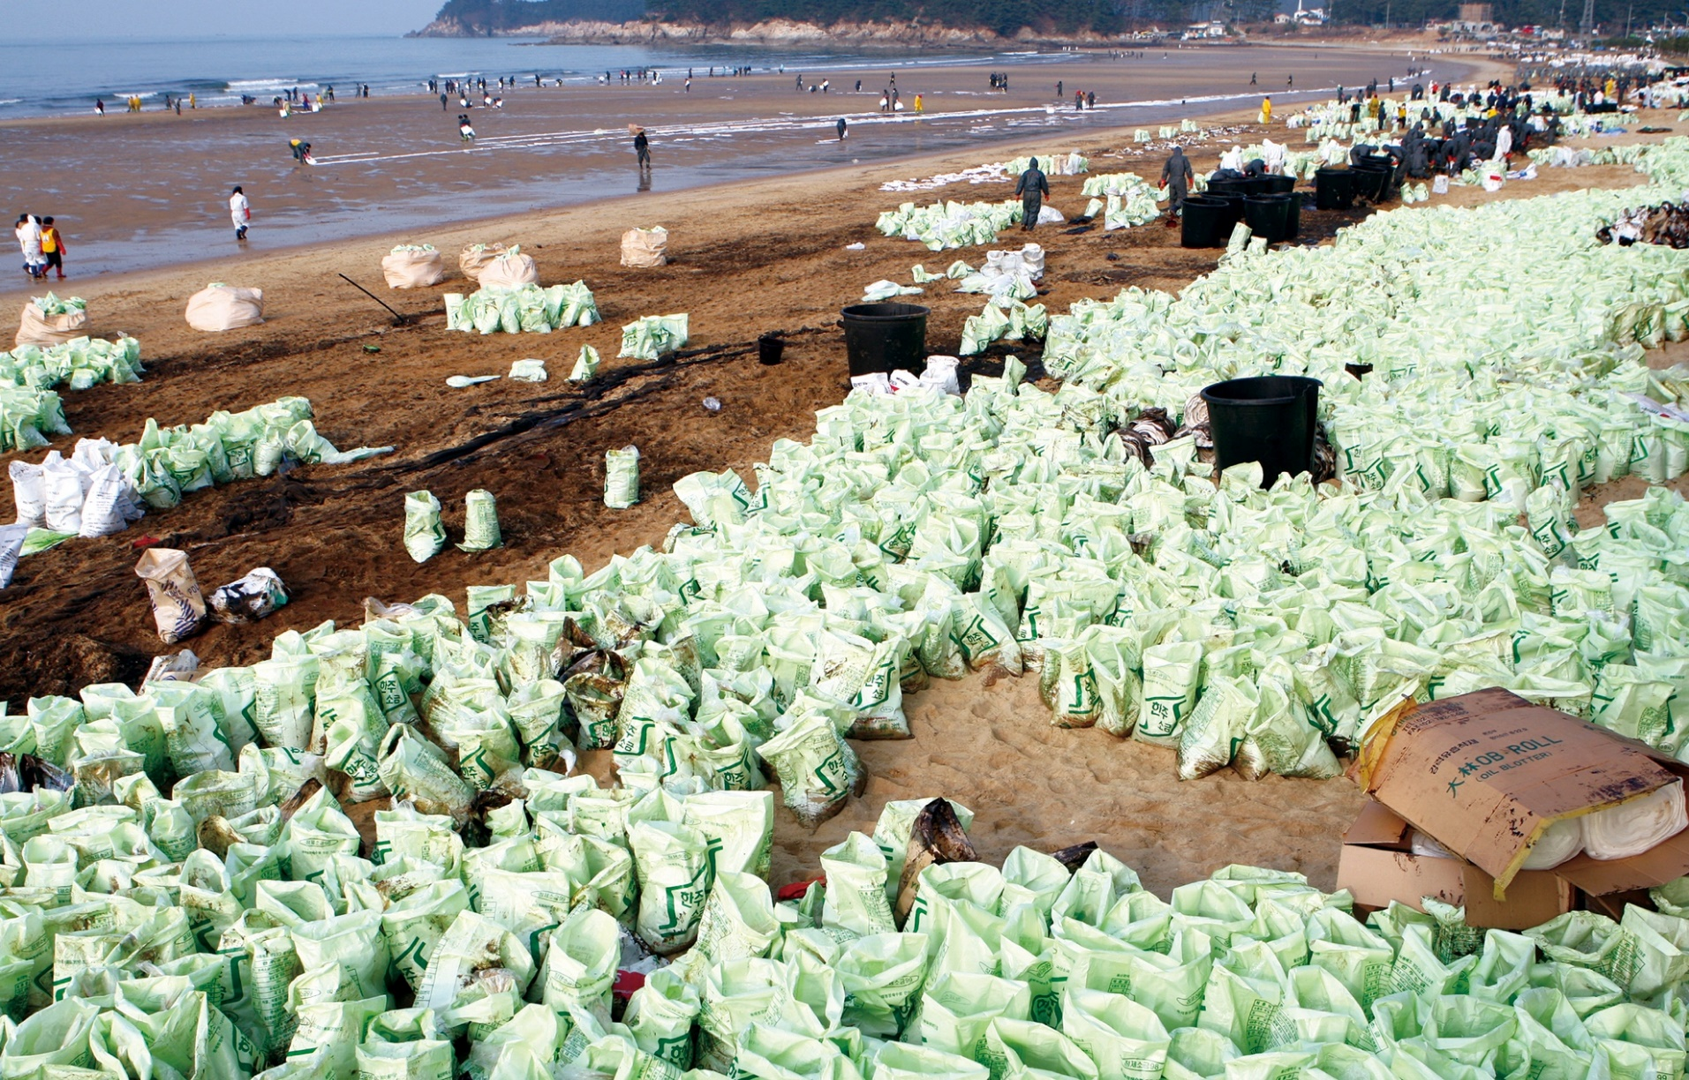
Temporary Storage
Source: Korea Coast Guard
CGPRT(W) : Ensuring Clean Seas and Coasts in Western Region ……

Slide 19
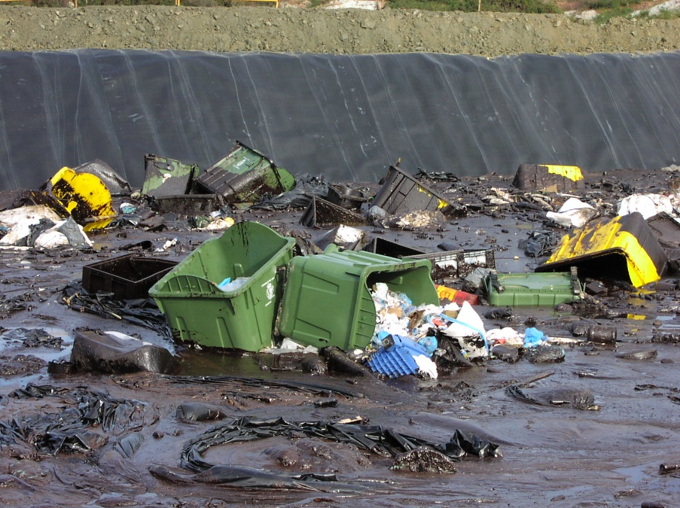
Waste Must be Separated!
By waste type
Oil
Solids (debris)
Oil content
Facilitate storage, transport and final disposal
Ensure training and monitoring of working crews
Ensure appropriate containers are in place for all waste types at recovery sites
Source: ITOPF
CGPRT(W) : Ensuring Clean Seas and Coasts in Western Region ……

Slide 20
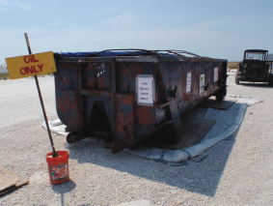
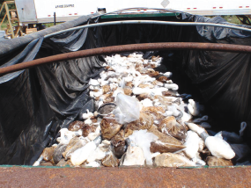
Think about Transfers!
Source: OSRL
CGPRT(W) : Ensuring Clean Seas and Coasts in Western Region ……

Slide 21
Transportation
Minimize waste before transportation
Minimize “double handling”
Prevent oiling of new areas
(secondary contamination)
CGPRT(W) : Ensuring Clean Seas and Coasts in Western Region ……

Slide 22
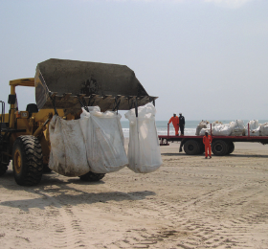
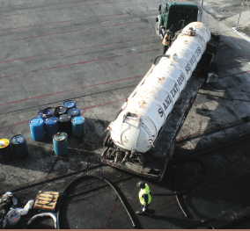
Waste Transportation
Source: OSRL
Source: OSRL
CGPRT(W) : Ensuring Clean Seas and Coasts in Western Region ……

Slide 23
Final Disposal
Re-use (after treatment)
Direct disposal − landfill
Stabilization - quick lime, road construction
Incineration
Land farming and composting
CGPRT(W) : Ensuring Clean Seas and Coasts in Western Region ……

Slide 24
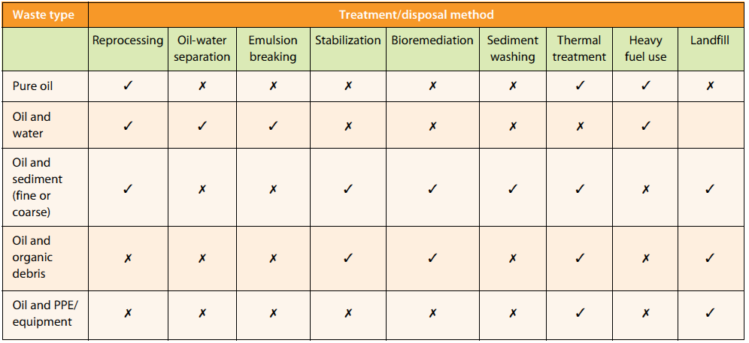
Treatment and Disposal Methods
Source: IPIECA
CGPRT(W) : Ensuring Clean Seas and Coasts in Western Region ……

Slide 25
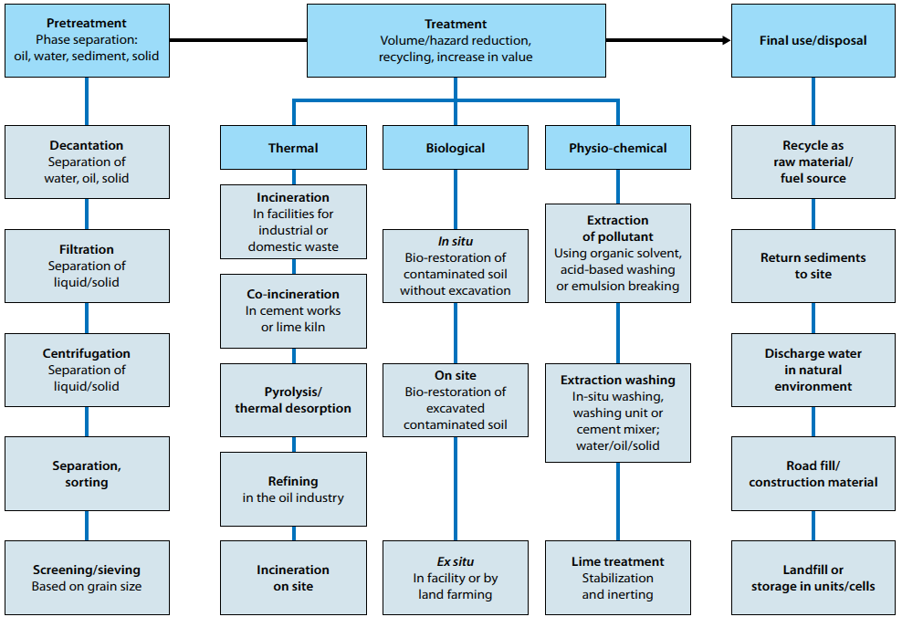
Summary of Options
Source: IPIECA
CGPRT(W) : Ensuring Clean Seas and Coasts in Western Region ……

Slide 26
Conclusion
Waste management can affect response effectiveness
Minimize – Segregate
Think about the waste stream
Storage
Transfer
Transport
CGPRT(W) : Ensuring Clean Seas and Coasts in Western Region ……

Slide 27
Any questions?
CGPRT(W) : Ensuring Clean Seas and Coasts in Western Region ……

